Slide 1

Model
Phase/Amplitude mask
Focusing lens
R_{max}
R_{m}
y
R₃
R₂
x
R₁
θ_{m}
Plane wave
α
E(r,ϕ,z)
θ₁
θ₂
θ₃
z
z=0
Focal plane
f

Slide 2
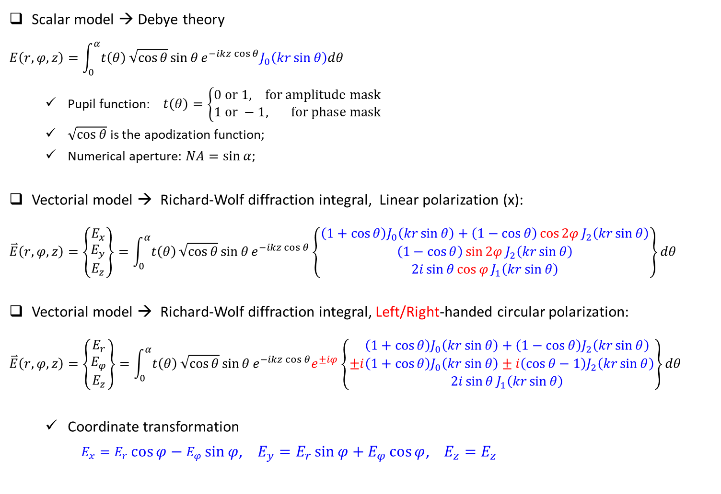
Scalar model VS Vectorial model
Scalar model → Debye theory
$$E\left(r,φ,z\right)=\int_{0}^{α}{t\left(θ\right)}\sqrt{\cos{θ}}\sin{θ}e^{−ikz\cos{θ}}J_{0}\left(kr\sin{θ}\right)dθ$$
Pupil function: $t\left(θ\right)=\left\{\begin{matrix}0 or 1, for amplitude mask \\ 1 or −1, for phase mask\end{matrix}\right.$
$\sqrt{\cos{θ}}$ is the apodization function;
Numerical aperture: $NA=\sin{α}$;
Vectorial model → Richard-Wolf diffraction integral, Linear polarization (x):
$$\overset{⃑}{E}\left(r,φ,z\right)=\left\{\begin{matrix}E_{x} \\ E_{y} \\ E_{z}\end{matrix}\right\}=\int_{0}^{α}{t\left(θ\right)}\sqrt{\cos{θ}}\sin{θ}e^{−ikz\cos{θ}}\left\{\begin{matrix}\left(1+\cos{θ}\right)J_{0}\left(kr\sin{θ}\right)+\left(1−\cos{θ}\right)\cos{2φ}J_{2}\left(kr\sin{θ}\right) \\ \left(1−\cos{θ}\right)\sin{2φ}J_{2}\left(kr\sin{θ}\right) \\ 2i\sin{θ}\cos{φ}J_{1}\left(kr\sin{θ}\right)\end{matrix}\right\}dθ$$
Vectorial model → Richard-Wolf diffraction integral, Left/Right-handed circular polarization:
$$\overset{⃑}{E}\left(r,φ,z\right)=\left\{\begin{matrix}E_{r} \\ E_{φ} \\ E_{z}\end{matrix}\right\}=\int_{0}^{α}{t\left(θ\right)}\sqrt{\cos{θ}}\sin{θ}e^{−ikz\cos{θ}}e^{±iφ}\left\{±\begin{matrix}\left(1+\cos{θ}\right)J_{0}\left(kr\sin{θ}\right)+\left(1−\cos{θ}\right)J_{2}\left(kr\sin{θ}\right) \\ i\left(1+\cos{θ}\right)J_{0}\left(kr\sin{θ}\right)±i\left(\cos{θ−1}\right)J_{2}\left(kr\sin{θ}\right) \\ 2i\sin{θ}J_{1}\left(kr\sin{θ}\right)\end{matrix}\right\}dθ$$
Coordinate transformation
$E_{x}=E_{r}\cos{φ}−E_{φ}\sin{φ}$, $E_{y}=E_{r}\sin{φ}+E_{φ}\cos{φ}$, $E_{z}=E_{z}$

